Slide 1
Predicting Tech Salaries: A Data-Driven Analysis of U.S. Labor Statistics
DATA 606: Capstone Project
Team A
Dereck Román Rosario
Simran Shah
Gelareh Vakili
Notes:
“Hello everyone. We’re Team A—Simran Shah, Gelareh Vakili, and Dereck Román Rosario—and our project is titled Predicting Tech Salaries: A Data-Driven Analysis of U.S. Labor Statistics.
This project focuses on building machine learning models to predict developer and tech-sector salaries in the United States using government-sourced labor statistics. We chose this topic because salary transparency and regional equity in the tech industry are increasingly important in workforce development and public policy.”

Slide 2
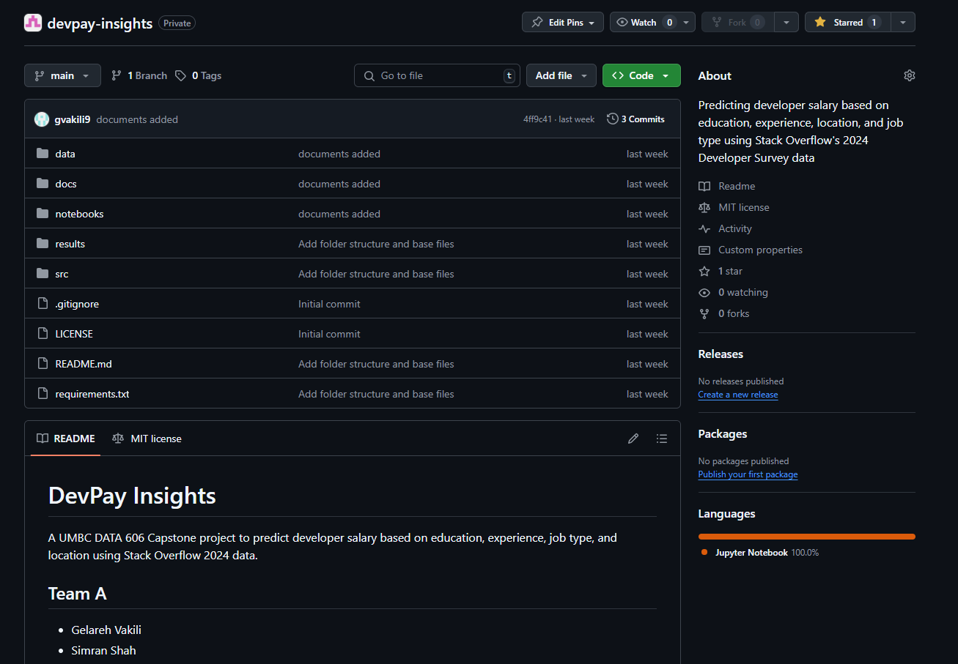
Project Repository – DevPay Insights
Project Repository:
https://github.com/DATA606-Capstone-Project/devpay-insights
Key Points:
Organized into folders: data, docs, notebooks, results, src
Includes source code, exploratory data analysis (EDA) for both BLS (primary) and SO (secondary) datasets
Licensed under MIT; includes requirements.txt for environment setup
Maintained collaboratively by Simran Shah, Gelareh Vakili, and Dereck Román Rosario
README describes the project objective: salary prediction using U.S. labor data and developer survey insights
Notes:
“We’re managing our project on GitHub, where you’ll find our datasets, notebooks, EDA visualizations, and source code.
The repo is organized into data, docs, notebooks, and results folders. We also included a detailed README with our project objectives and setup instructions.
We’re maintaining it collaboratively, and updates are synced weekly as we progress through phases.”

Slide 3
Project Introduction & Objective
What is this project about?
Why did we choose this topic?
Research Question:
This project aims to build a machine learning model to predict annual developer or tech-sector salaries using publicly available labor data, focusing on regional and occupational trends. The goal is to understand how location, job title, and industry influence compensation.
Supports analysis of salary transparency and labor market dynamics
Helps uncover patterns in wage distribution across occupations and states
Enables insight into structural disparities using real U.S. government data
Can we predict salaries across tech occupations using job title, industry, and region data from the Bureau of Labor Statistics?
Notes:
“Our main goal is to predict annual salaries for U.S. tech occupations by analyzing structured labor data from the Bureau of Labor Statistics.
We're particularly interested in how job title, location, and industry influence compensation.
The broader objective is to support workforce transparency and uncover regional or structural disparities using real government-verified data.”

Slide 4
Primary Dataset: U.S. Bureau of Labor Statistics (OEWS)
Source:
U.S. Bureau of Labor Statistics (BLS)
Download Link
Dataset Summary:
Name: Occupational Employment and Wage Statistics (OEWS)
Year: 2024 release
Format: Excel (XLSX) and CSV
Public and government-verified source
Updated annually and used in labor market research
Why This Dataset?
Rich, structured wage data by occupation and location
Suitable for real-world salary prediction applications
No account or API key needed, fully reproducible
Notes:
“Our primary dataset is the Occupational Employment and Wage Statistics, or OEWS, from the Bureau of Labor Statistics.
It’s publicly available, regularly updated, and used in official government and economic research.
We’re working with the 2024 release, which provides detailed employment and wage information across the U.S. by occupation and location.”

Slide 5
BLS OEWS: Dataset Composition and Key Variables
Size & Structure:
~400,000 rows
~32 columns
Covers all U.S. states, metro areas, and hundreds of occupations
Key Fields Selected for Modeling:
OCC_TITLE – Occupation title
AREA_NAME – State or metro region
A_MEDIAN, A_MEAN – Annual median and mean salary
TOT_EMP – Estimated total employment
NAICS_TITLE – Industry classification
Planned Use:
Use occupational, regional, and salary info as features
Build predictive models to estimate salary
Cluster jobs and regions based on wage and employment patterns
Notes:
“The dataset has around 400,000 records and 32 columns. It includes detailed occupation and salary data broken down by state and metro area. For modeling, we’re focusing on fields like occupation title, area name, median and mean salary, industry classification, and total employment. These variables will serve as inputs for regression and possibly clustering models.”

Slide 6
Backup Dataset: Stack Overflow Developer Survey 2024
Source:
Stack Overflow Insights
https://survey.stackoverflow.co/datasets/stack-overflow-developer-survey-2024.zip
Dataset Summary:
Format: CSV (inside ZIP archive)
File Size: ~85MB
Responses: ~89,000 developers
Global survey results on job role, education, experience, and salary
Key Features (Used for Modeling):
ConvertedCompYearly – Annual compensation (target)
EdLevel – Highest education level
DevType – Developer role
YearsCodePro – Years of professional experience
Country – Country of employment
Planned Use (if needed):
Cross-checking salary trends by role/education
Predictive modeling with individual-level responses
Supplement BLS insights with international survey data
Notes:
“Our secondary dataset is the 2024 Stack Overflow Developer Survey, which contains responses from about 89,000 developers globally. It includes fields like education level, years of experience, and salary. Although it’s not our primary focus, we may use it for supplemental analysis to cross-check patterns, especially if time allows.”

Slide 7
What Are We Analyzing and Why?
ML Task:
Regression – Predicting continuous annual salaries (e.g., median wage)
Why this project?
Uses government-verified salary data (BLS) to promote transparency and equity
Relevant for real-world applications in labor analytics and workforce development
Allows us to apply supervised learning on large, structured public data
Target Variable:
A_MEDIAN or A_MEAN from BLS OEWS
Features:
OCC_TITLE, AREA_NAME, NAICS_TITLE, TOT_EMP
Dataset Overview Recap:
BLS OEWS 2024
~400,000 records, 32 columns
Occupation- and region-based U.S. wage statistics
Notes:
“We’re conducting a regression task—predicting continuous values like median salary.
We’re using the BLS data to build models that estimate salaries based on job title, region, and industry.
We chose this project because it’s grounded in real, structured data and has clear, real-world relevance for labor analytics, workforce equity, and policy analysis.”

Slide 8
What Have Others Done with Salary Data?
Examples of Similar Projects:
Stack Overflow Salary Explorations:
Kaggle Notebooks (Outside Scope):
BLS Visualizations in Public Sector Reports:
Community-built dashboards and salary comparisons using the Developer Survey. Most focus on visual summaries rather than prediction.
Regression models using Stack Overflow or Glassdoor data. Typically explore role, education, and location but rely on self-reported, global survey data.
Static reports analyzing employment and wage trends by region/industry without predictive modeling.
Notes:
“Existing work in this area often focuses on dashboards and summary statistics.
Many rely on survey data from Stack Overflow or Glassdoor, which may lack standardization and only offer descriptive insights.
We found very few public projects that apply machine learning to government datasets like BLS OEWS—especially for predictive modeling.”

Slide 9
Gaps in Prior Work & Our Contribution
What’s Missing in Existing Work:
Most analyses are descriptive only, not predictive
Limited use of BLS data in machine learning workflows
Rare exploration of geographic wage modeling or job clustering
Over-reliance on self-reported international survey data
Our Differentiation:
Using a U.S. government dataset with standardized, occupation-level salary data
Applying supervised regression modeling to predict wage outcomes
Exploring regional wage prediction and occupation-based clustering
Potential to supplement with SO dataset for deeper individual-level insights
Notes:
“What’s missing is the predictive component. Most prior analyses are descriptive only, and they rarely use government datasets.
Our work adds value by applying supervised regression methods to standardized labor data.
We also explore geographic wage modeling and occupation-based clustering, which are rarely examined in academic or industry studies.”

Slide 10
Implementation Plan: Data Preparation & Modeling
Data Preparation:
Handle missing values (e.g., unreported employment or wages)
Normalize wage columns if needed (A_MEDIAN, A_MEAN)
One-hot encode categorical features (e.g., AREA_NAME, OCC_TITLE, NAICS_TITLE)
Filter out aggregate totals and suppressions (e.g., “All Occupations”)
Modeling Methods (Planned):
Linear Regression: Baseline model for interpretability
Random Forest Regressor: Handles non-linearity and feature importance
XGBoost Regressor: Gradient boosting for improved accuracy
Backup Tasks (if time allows):
Clustering: Group jobs or regions based on salary/employment patterns
Cross-Dataset Comparison: Align BLS and SO data on job types and trends
Notes:
“Here’s our planned pipeline. We started by cleaning the BLS dataset—removing suppressed rows and filtering for valid occupations and states. We’ll encode categorical variables like region and job title, normalize wages if needed, and test multiple regression models, including Linear Regression, Random Forest, and XGBoost. If time permits, we’ll also explore clustering and compare results with the SO dataset.”

Slide 11
Features and How We’ll Measure Performance
Key Features for Modeling:
Planned Feature Engineering:
Evaluation Metrics:
OCC_TITLE – Job title
AREA_NAME – State or metro region
A_MEDIAN or A_MEAN – Target salary variable
TOT_EMP – Total estimated employment
NAICS_TITLE – Industry classification
Categorical encoding (One-hot or Label Encoding)
Possible grouping or binning of job titles/regions
Salary normalization (log transformation if skewed)
Root Mean Squared Error (RMSE): Penalizes large errors
Mean Absolute Error (MAE): Intuitive and robust
R² Score: Overall variance explained by the model
Notes:
“These are our main features: occupation title, region, total employment, and industry. We’ll use one-hot or label encoding where needed and may apply log transformations if salary distributions are skewed. For model evaluation, we’ll rely on RMSE, MAE, and R² to measure accuracy and generalizability.”

Slide 12
Exploratory Data Analysis (EDA): Initial Observations
Purpose of EDA:
Understand data distributions and outliers
Identify patterns and trends across occupations and regions
Detect and handle missing or suppressed data
Initial Steps Completed:
Loaded and cleaned all_data_M_2024.xlsx from BLS
Dropped rows with suppressed salary data
Filtered for valid U.S. states and specific occupations
Removed summary categories (e.g., “All Occupations”)
Notes:
“We began our EDA by loading and cleaning the 2024 OEWS Excel file. We dropped rows with suppressed wage data, removed aggregate totals like 'All Occupations', and filtered for valid state entries. This gave us a cleaned dataset ready for exploration, modeling, and regional analysis.”

Slide 13
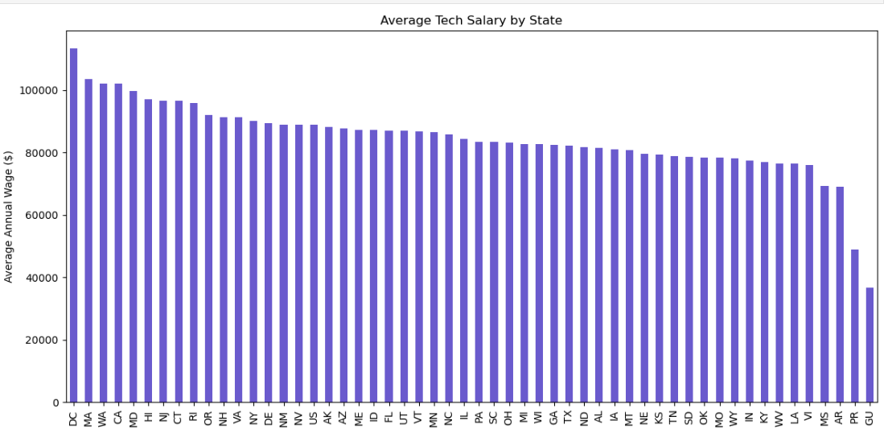
Regional Salary Trends Across the U.S.
Notes:
“This bar chart shows the median tech salary by state, ranked from highest to lowest. At the top of the chart is Washington, D.C., which currently leads the country in tech compensation. This aligns with its concentration of federal contractors, research firms, and policy-driven tech roles. Other high-salary states include California, Massachusetts, and New York—also known for dense tech ecosystems and higher costs of living. On the other end, states in the Midwest and South show more modest wages. This geographic variation is important context for our modeling and confirms that location is a critical predictive feature.”

Slide 14
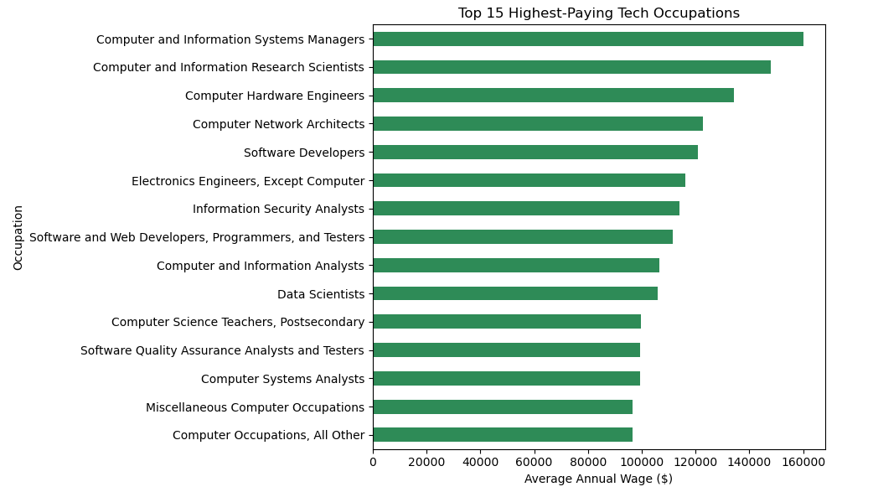
Top-Paying Tech Occupations
Notes:
“Here we’ve highlighted the top-paying tech occupations across the country. Engineering managers and computer research scientists top the list, earning well over $150,000 annually. This confirms that management and R&D-focused roles command the highest wages in tech.”

Slide 15
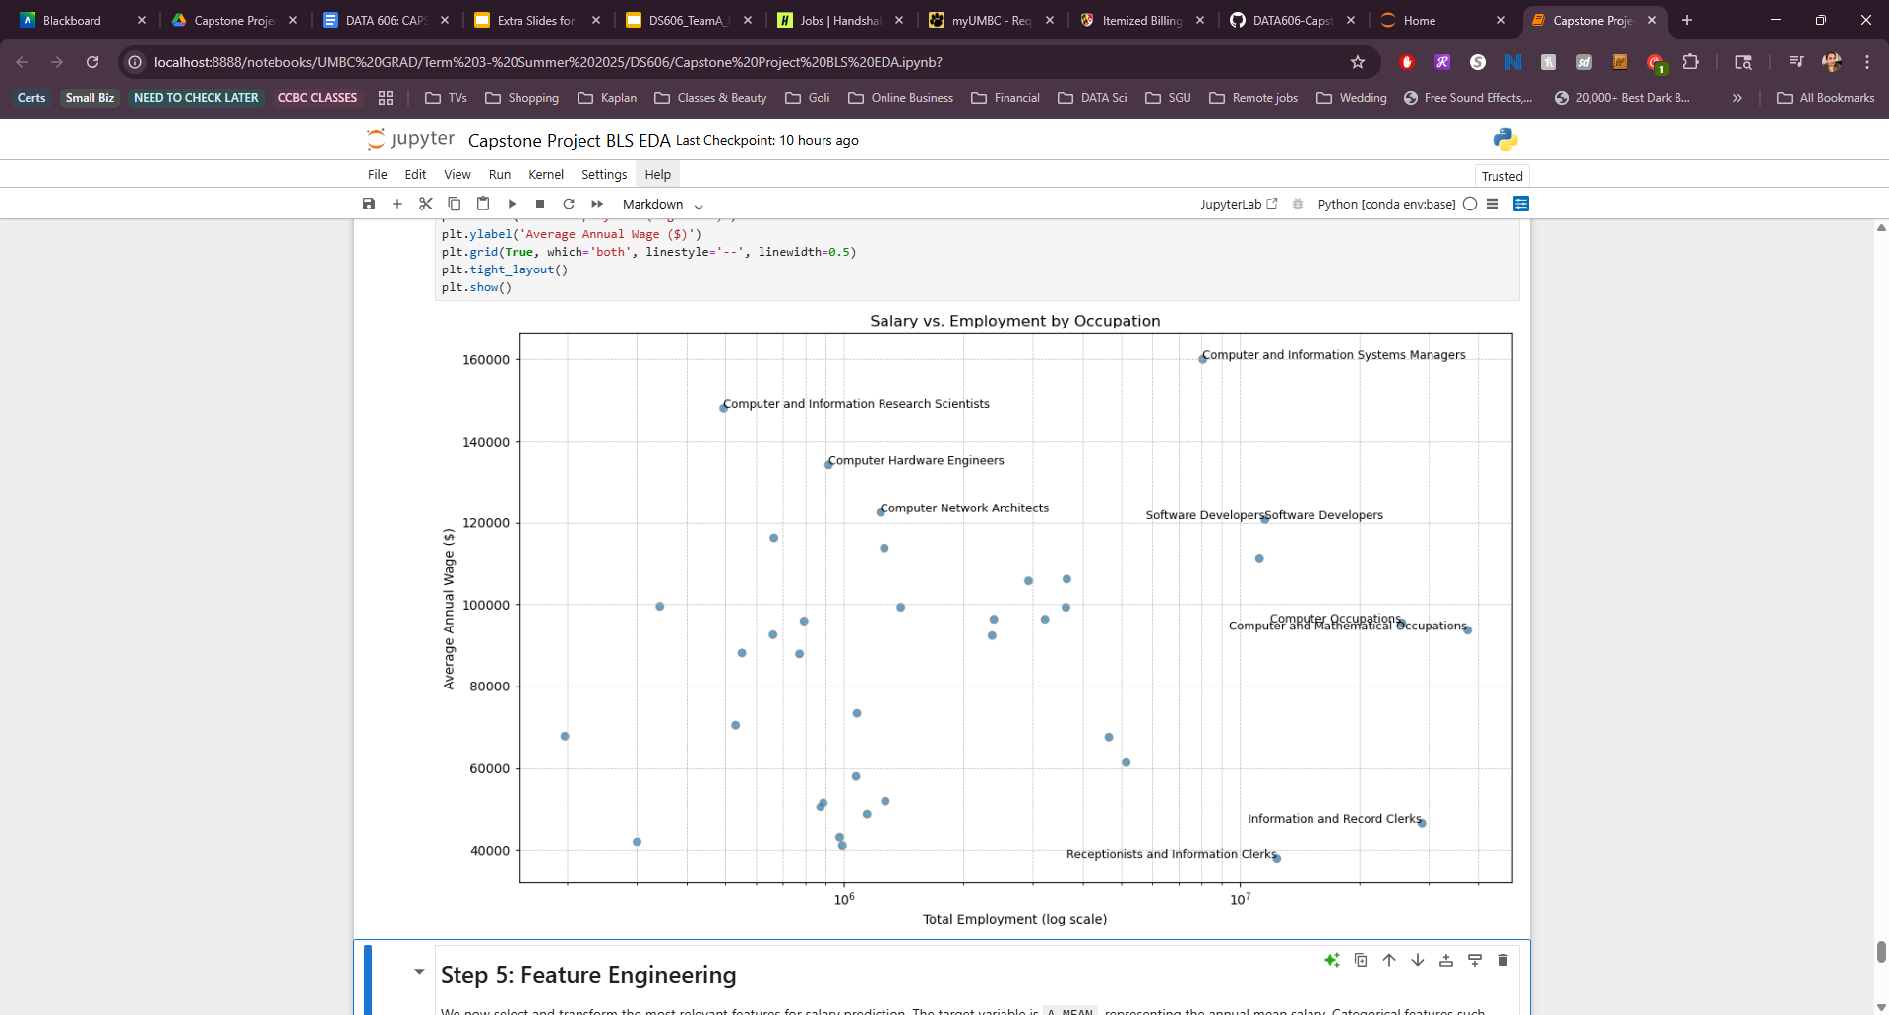
Do Highly-Paid Roles Also Employ the Most People?
This chart illustrates the relationship between employment volume and average annual wage across tech occupations. Using a logarithmic scale, we observe that higher salaries do not correlate directly with larger workforce sizes. Managerial and research roles yield the highest wages but employ fewer individuals, while more common roles like software developers offer moderate salaries with broader representation.
Notes:
“This scatter plot compares total employment to median salary using a log scale. We notice that the most common jobs—like software developers—have moderate wages but large workforce sizes. Conversely, high-paying jobs like research scientists are much rarer. This suggests salary does not always scale with role popularity.”
In this chart, we’re analyzing the relationship between how much tech jobs pay and how many people are employed in each role. We used a logarithmic scale on the x-axis to account for the large range in employment numbers — some roles employ just a few hundred people, while others span into the millions.
What we found is that high salaries don’t necessarily align with high employment. For example, Computer and Information Systems Managers and Computer Research Scientists are among the highest-paid roles, but they have relatively small workforce sizes. On the other hand, Software Developers and IT Support roles employ significantly more people but offer more moderate wages.
This distinction is important for our project because it shows the diversity in job structure and compensation across tech roles — which supports our goal of identifying key predictors for tech salaries.

Slide 16
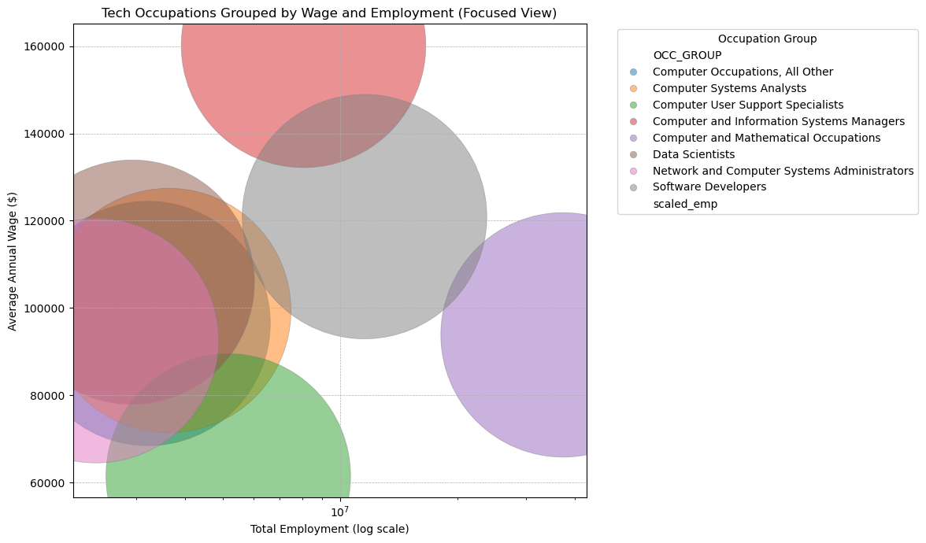
Grouping Occupations by Wage and Employment
Notes:
In this final chart, we present a visually enhanced bubble plot focusing only on core tech occupations. The x-axis shows the total number of people employed in each role, while the y-axis represents the average annual wage.
Each bubble is color-coded by occupation group, and we've removed less relevant categories like receptionists and clerical roles to keep the view clean and focused. While bubble size is uniformly scaled for presentation clarity, we maintain a logarithmic x-axis to handle the wide range of employment values.
From this view, we can clearly observe where high-paying specialized roles differ from widely-employed support positions, giving us important structural insight into the tech labor market.

Slide 17
Execution Plan and Milestones
Phase 1
Project Pitch
Phase 2
Modeling
Phase 3
Interpretation
Phase 4
Final Delivery
May 25 – June 17
June 18 – July 15
July 16 – August 7
August 8 – August 15
Finalize Topic
Collect datasets
Perform initial EDA
Preprocessing
Feature engineering
Train/test regression models
Model evaluation
Visualization
Iterate w/secondary dataset
Prepare final presentation and written report
Team Coordination:
Weekly GitHub check-ins and notebook sync
Individual responsibilities divided by modeling, EDA, and presentation
Notes:
“Our project is structured into four phases.
We’re currently finishing Phase 1, where we defined our topic, cleaned data, and began EDA.
Next, we’ll move into modeling and evaluation, followed by interpretation and delivery in the final weeks.
Each team member is responsible for a specific part, and we meet regularly to sync.”

Slide 18
Project Risks and How We’ll Address Them
1. Data Suppression or Missing Fields
Risk: Some occupations or regions have missing salary/employment data
Mitigation: Remove suppressed rows; filter to complete, high-quality records
2. Feature Encoding Challenges
Risk: Categorical features like job titles and regions are numerous and inconsistent
Mitigation: Apply grouping, one-hot encoding, and standard occupation mappings
3. Model Overfitting or Poor Generalization
Risk: Complex models may perform well on training data but fail on unseen data
Mitigation: Use cross-validation, compare with baseline models, keep it interpretable
4. Time Constraints
Risk: Limited time to implement advanced techniques (e.g., clustering, dashboards)
Mitigation: Prioritize regression pipeline; use secondary dataset only if time permits
Notes:
“We’ve identified four key risks: missing data, encoding complexity, model overfitting, and time constraints. We’re handling these through filtering, encoding strategies, baseline models for comparison, and a flexible timeline that prioritizes core tasks. Our backup tasks will only proceed if the core modeling pipeline is completed on time.”

Slide 19
Project Summary and What We’ve Accomplished
What We’re Doing:
Predicting U.S. tech salaries using official labor statistics from the BLS OEWS 2023 dataset
Using regression models to uncover how job titles, regions, and industries affect compensation
Why It Matters:
Supports salary transparency and workforce equity
Leverages real, standardized government data — not just surveys
Can inform job seekers, policy makers, and HR systems
What We’ve Done So Far:
Identified, cleaned, and explored a robust primary dataset
Planned and documented implementation strategy and evaluation metrics
Explored supplemental datasets and visualized initial insights
What’s Next:
Begin model training and refinement
Expand to clustering or secondary analysis (if time allows)
Deliver interpretable results in final presentation
Notes:
“To summarize: we’re building salary prediction models using the BLS OEWS dataset. We’ve completed data exploration, outlined our modeling plan, and started initial visualizations. Next steps include finalizing our regression models, exploring clustering, and integrating the SO dataset for validation if time permits.”

Slide 20
References & Data Sources
Datasets:
U.S. Bureau of Labor Statistics (OEWS 2023) https://www.bls.gov/oes/special-requests/oesm24all.zip
Stack Overflow Developer Survey 2024 https://survey.stackoverflow.co/datasets/stack-overflow-developer-survey-2024.zip
Research & Background:
Stack Overflow Insights. (2024). Developer Survey Results.
U.S. Department of Labor. (2023). Occupational Employment and Wage Statistics (OEWS).
Pedregosa et al., (2011). Scikit-learn: Machine Learning in Python. Journal of Machine Learning Research.
Tools & Libraries:
Python 3.11, Pandas, Matplotlib, Seaborn, Scikit-learn
Jupyter Notebook, GitHub
Notes:
“This slide lists all our sources: BLS, Stack Overflow, and key tools like Scikit-learn and Pandas. We’ve relied exclusively on open-source libraries and public datasets to ensure full reproducibility.”

Slide 21
Thank you
Questions?
Notes:
“Thank you! We’re happy to take any questions or suggestions.
Feel free to visit our GitHub or reach out for more details.”

